Slide 1
Data Communications for a Global Environment
Lecture 10

Slide 2
Chapter 4
Data Communications for a Global Environment
Data Link Layer

Slide 3
Data Link Layer - Introduction
Data Communications for a Global Environment
Network Layer
Data Link Layer
Physical Layer
Major functions of a data link layer protocol
Media Access Control
Controlling when computers transmit
Error Control
Detecting and correcting transmission errors
Message Delineation
Identifying the beginning and end of a message

Slide 4
Media Access Control (MAC)
Data Communications for a Global Environment
Controlling when and what computers transmit
Important when more than one computer wants to send data at the same time over the same, shared circuit
Point-to-point half duplex links
computers take turns
Multipoint configurations
Ensure that no two computers attempt to transmit data at the same time
Two possible approaches
Controlled access
Contention based access

Slide 5
Controlled Access
Data Communications for a Global Environment
Controlling access to shared resources
Acts like a stop light
Commonly used by mainframes (or its front end processor)
Determines which circuits have access to mainframe at a given time
Also used by some LAN protocols
Token ring, FDDI
Major controlled access methods
X-ON/X-OFF and Polling

Slide 6
Polling
Data Communications for a Global Environment
Process of transmitting to a client only if asked and/or permitted
Client stores the information to be transmitted
Server (periodically) polls the client if it has data to send
Client, if it has any, sends the data
If no data to send, client responds negatively, and server asks the next client
Types of polling
Roll call polling
Hub polling (also called token passing)

Slide 7
Roll Call Polling
Data Communications for a Global Environment
Check each client (consecutively and periodically) to see if it wants to transmit : A, B, C, D, E, A, B, …
Clients
D
D
C
E
E
B
Server
Server
A
Clients can also be prioritized so that they are polled more frequently: A, B, A, C, A, D, A, E, A, B, ..
Involves waiting: Poll and wait for a response
Needs a timer to prevent lock-up (by client not answering)

Slide 8
Hub Polling (Token Passing)
Data Communications for a Global Environment
E
D
One computer starts the poll:
sends message (if if any) then
passes the token on to the next computer
Token is a unique series of bits
A
token
C
B
Continues in sequence until the token reaches the first computer, which starts the polling cycle all over again

Slide 9
Contention Methods
Data Communications for a Global Environment
Transmit whenever the circuit is free
Collisions
Occurs when more than one computer transmitting at the same time
Need to determine which computer is allowed to transmit first after the collision
Used commonly in Ethernet LANs
Problematic in heavy usage networks

Slide 10
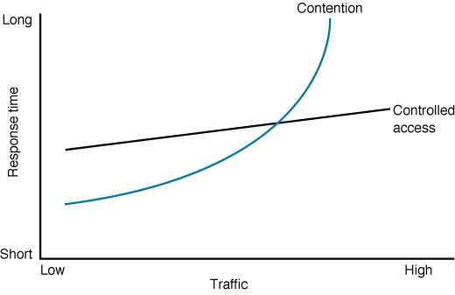
Relative Performance
Data Communications for a Global Environment
Depends on network conditions
When volume is high, performance deteriorates (too many collisions)
Work better for networks with high traffic volumes
Cross-over point: About 20 computers
Network more efficiently used
Work better for smaller networks with low usage

Slide 11
Error Control
Data Communications for a Global Environment
Handling of network errors caused by problems in transmission
Network errors
Can be a changing a bit value during transmission
Controlled by network hardware and software
Human errors:
Can be a mistake in typing a number
Controlled by application programs
Categories of Network Errors
Corrupted (data is changed from what it is)
Lost data (cannot find the data at all)
We cannot correct for these errors in the communication software

Slide 12
Error Control (Cont.)
Data Communications for a Global Environment
Error Rate
1 bit error in n bits transmitted, e.g., 1 in 500,000
Burst error
Many bits are corrupted at the same time
Errors not uniformly distributed
e.g., 100 in 50,000,000 → 1 in 500,000
Major functions
Preventing errors
Detecting errors
Correcting errors

Slide 13
Sources of Errors
Data Communications for a Global Environment
Line noise and distortion – major cause
More likely on electrical media
Undesirable electrical signal
Introduced by equipment and natural disturbances
Degrades performance of a circuit
Manifestation
Extra bits
“flipped” bits
Missing bits

Slide 14
Sources of Errors and Prevention
Data Communications for a Global Environment
Source of Error
What causes it
How to prevent it
Line Outages
Faulty equipment, Storms, Accidents (circuit fails)
White Noise
Movement of electrons (thermal energy)
Increase signal strength (increase SNR)
Impulse Noise
Sudden increases in electricity
(e.g., lightning, power surges)
Shield or move the wires
More important
Cross-talk
Multiplexer guard bands are too small or wires too close together
Increase the guard bands, or
move or shield the wires
Echo
Poor connections (causing signal to be reflected back to the source)
Fix the connections, or
tune equipment
Attenuation
Gradual decrease in signal over distance (weakening of a signal)
Use repeaters or amplifiers
Intermodulation Noise
Signals from several circuits combine
Move or shield the wires
Jitter
Analog signals change (small changes in amp., freq., and phase)
Tune equipment
mostly on analog
Harmonic Distortion
Amplifier changes phase (does not correctly amplify its input signal)
Tune equipment

Slide 15
Error Detection
Data Communications for a Global Environment
Sender calculates an Error Detection Value (EDV) and transmits it along with data
Receiver recalculates EDV and checks it against the received EDV
Mathematical
calculations
Mathematical
calculations
?
=
Data to be transmitted
EDV
If the same → No errors in transmission
If different → Error(s) in transmission
Larger the size, better error detection (but lower efficiency)

Slide 16
Error Detection Techniques
Data Communications for a Global Environment
Parity checks
Checksum
Cyclic Redundancy Check (CRC)

Slide 17
Parity Checking
Data Communications for a Global Environment
One of the oldest and simplest
A single bit added to each character
Even parity: number of 1’s remains even
Odd parity: number of 1’s remains odd
Receiving end recalculates parity bit
If one bit has been transmitted in error the received parity bit will differ from the recalculated one
Simple, but doesn’t catch all errors
If two (or an even number of) bits have been transmitted in error at the same time, the parity check appears to be correct
Detects about 50% of errors

Slide 18
Examples of Using Parity
Data Communications for a Global Environment
To be sent: Letter V in 8-bit ASCII: 01101010
sender
receiver
EVEN parity
011010100
number of 1’s is even add a zero parity bit
parity bit
To be sent: Letter W in 8-bit ASCII: 00011010
ODD parity
sender
receiver
000110100
number of 1”s is odd add
a 0 as the parity bit
parity bit

Slide 19
Checksum
Data Communications for a Global Environment
A checksum (usually 1 byte) is added to the end of the message
It is 95% effective
Method:
Add decimal values of each character in the message
Divide the sum by 255
The remainder is the checksum value

Slide 20
Cyclic Redundancy Check (CRC)
Data Communications for a Global Environment
P / G = Q + R / G
Example:
P = 58
G = 8
Q = 7
R = 2
Message (treated as one long binary number)
Quotient
(whole number)
Remainder:
added to the message as EDV
could be 8 bits, 16 bits, 24 bits, or 32 bits long
CRC16 has R of 16 bits
A fixed number (determines the length of the R)
Most powerful and most common
Detects 100% of errors (if number of errors <= size of R)
Otherwise: CRC-16 (99.998%) and CRC-32 (99.9999%)

Slide 21
Error Correction
Data Communications for a Global Environment
Once detected, the error must be corrected
Error correction techniques
Retransmission (or, backward error correction)
Simplest, most effective, least expensive, most commonly used
Corrected by retransmission of the data
Receiver, when detecting an error, asks the sender to retransmit the message
Often called Automatic Repeat Request (ARQ)
Forward Error Correction
Receiving device can correct incoming messages itself

Slide 22
Automatic Repeat Request (ARQ)
Data Communications for a Global Environment
Process of requesting that a data transmission be resent
Main ARQ protocols
Stop and Wait ARQ (A half duplex technique)
Sender sends a message and waits for acknowledgment, then sends the next message
Receiver receives the message and sends an acknowledgement, then waits for the next message
Continuous ARQ (A full duplex technique)
Sender continues sending packets without waiting for the receiver to acknowledge
Receiver continues receiving messages without acknowledging them right away

Slide 23
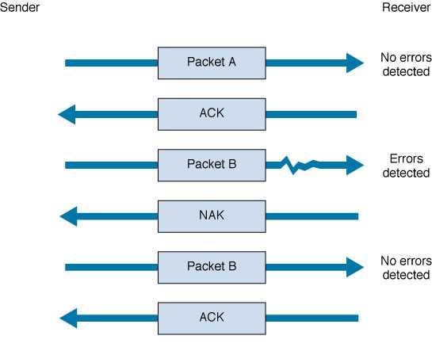
Stop and Wait ARQ
Data Communications for a Global Environment
Sender
Receiver
Sends the packet, then waits to hear from receiver.
Sends
acknowledgement
Sends the next packet
Sends negative acknowledgement
Resends the packet
again
Sends
acknowledgement

Slide 24
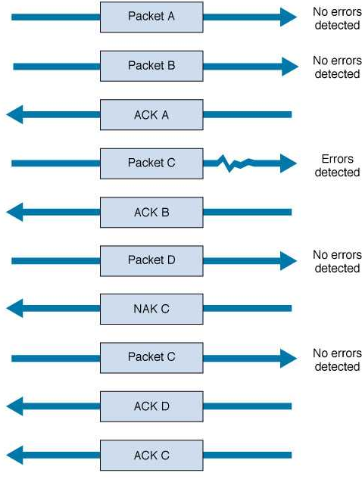
Continuous ARQ
Data Communications for a Global Environment
Sender sends packets continuously without waiting for receiver to acknowledge
Notice that acknowledgments now identify the packet being acknowledged.
Receiver sends back a NAK for a specific packet to be resent.

Slide 25
Flow Control with ARQ
Data Communications for a Global Environment
Ensuring that sender is not transmitting too quickly for the receiver
Stop-and-wait ARQ
Receiver sends an ACK or NAK when it is ready to receive more packets
Continuous ARQ:
Both sides agree on the size of the “sliding window”
Number of messages that can be handled by the receiver without causing significant delays

Slide 26
Flow Control Example
Data Communications for a Global Environment
window size =4
sender
receiver
0 1 2 3 4 5 6 7 8 9
...3 2 1 0
ACK 0...
(slide window)
...4
0 1 2 3 4 5 6 7 8 9
ACK 4...
(slide window)
…8 7 6 5
0 1 2 3 4 5 6 7 8 9
ACK 7..
set window size to 2
(slide window)
..9
0 1 2 3 4 5 6 7 8 9
(timeout)
...9 8
0 1 2 3 4 5 6 7 8 9

Slide 27
Forward Error Correction (FEC)
Data Communications for a Global Environment
Receiving device can correct incoming messages itself (without retransmission)
Requires extra corrective information
Sent along with the data
Allows data to be checked and corrected by the receiver
Amount of extra information: usually 50-100% of the data
Useful for satellite transmission
One way transmissions (retransmission not possible)
Transmission times are very long (retransmission will take a long time)
In this situation, relatively insignificant cost of FEC

Slide 28
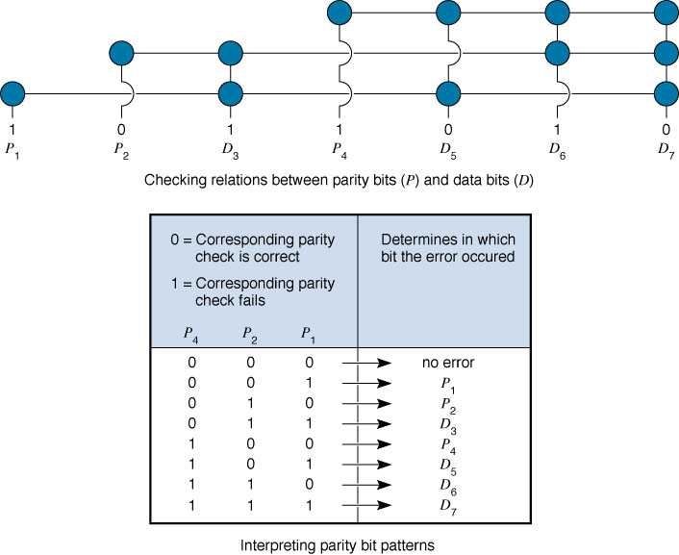
Hamming Code – An FEC Example
Data Communications for a Global Environment
Each data bit figures into three EVEN parity bit calculations
If any one bit (parity or data) changes → change in data bit can be detected and corrected
Only works for one bit errors

Slide 29
Ethernet (IEEE 802.3)
Data Communications for a Global Environment
Most widely used LAN protocol, developed jointly by Digital, Intel, and Xerox, now an IEEE standard
Uses contention based media access control
Byte-count data link layer protocol
No transparency problem
uses a field containing the number of bytes (not flags) to delineate frames
Error correction: optional

